Slide 2
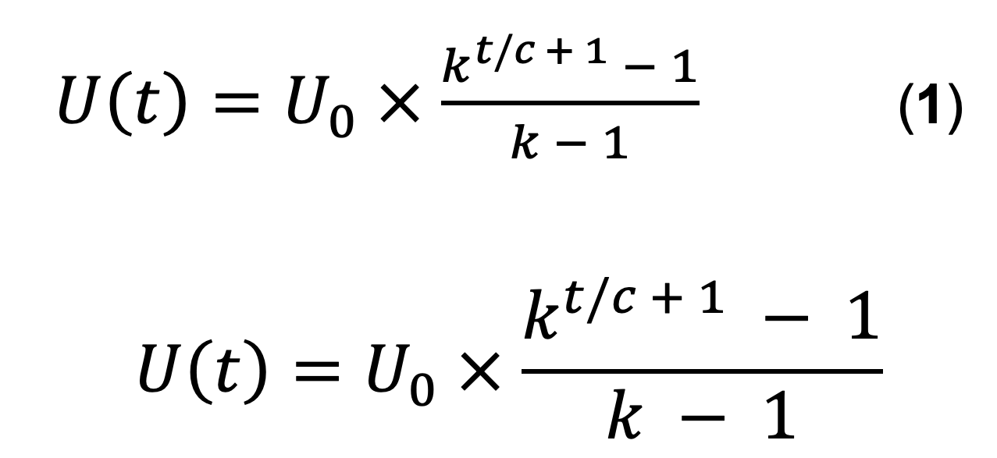

Slide 3
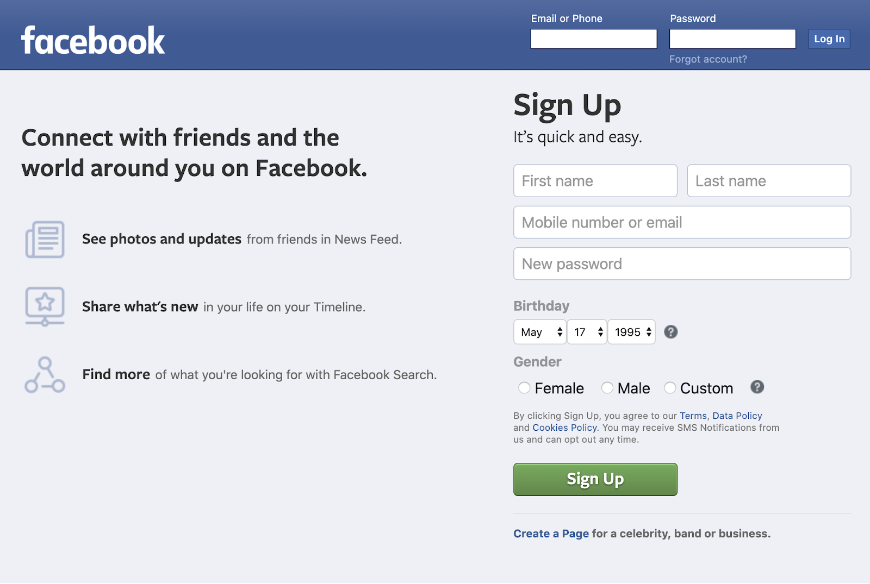
Maximize invitation rate
Current user sees
Two-way invite incentive
Pre-populated invite list
Minimal required input fields
Value proposition to new user
Invited new user sees
Maximize acceptance rate

Slide 4
(Non-users)
(Non-users)
conversion
Cumulative registered users
conversion
retention
retention
Active users
Active users
churn (late)
resurrection
churn (late)
resurrection
New users
New users
Lost users
Lost users
churn (early)
churn (early)
Cumulative registered users

